Slide 1
19CSE211 COMPUTER ARCHITECTURE & ORGANIZATION
Single Cycle Implementation-Continuation

Slide 2
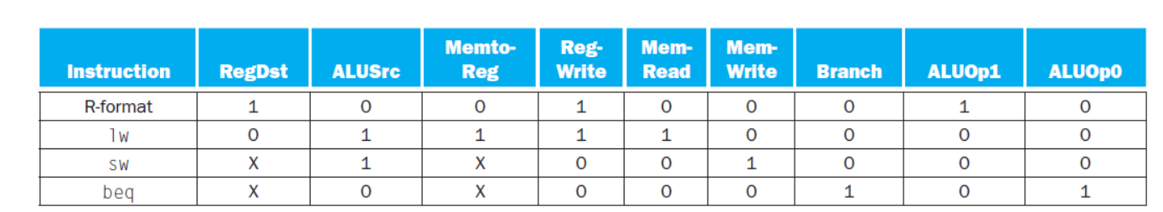
Setting of Control Lines

Slide 3
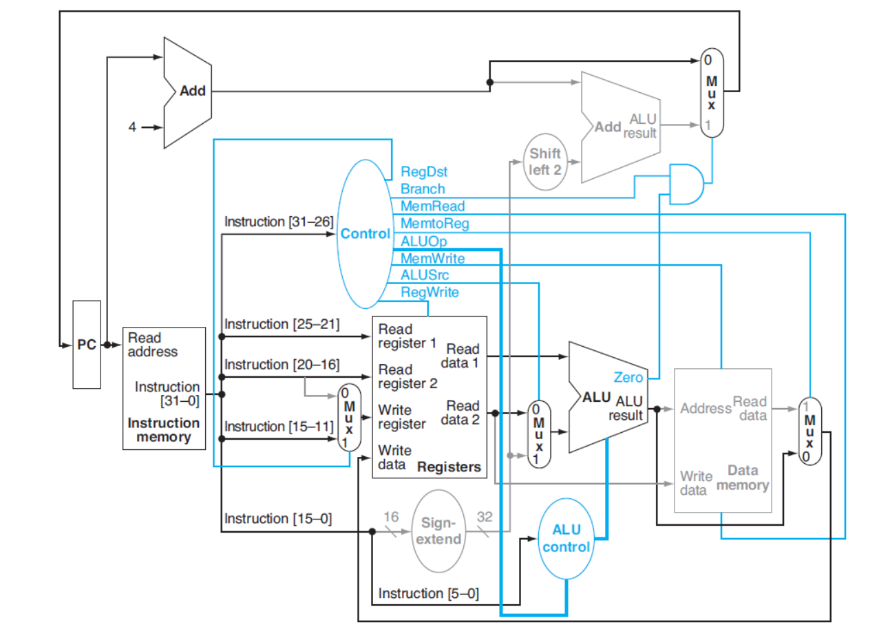
Data Path for R-Operation-add $t1,$t2,$t3

Slide 4
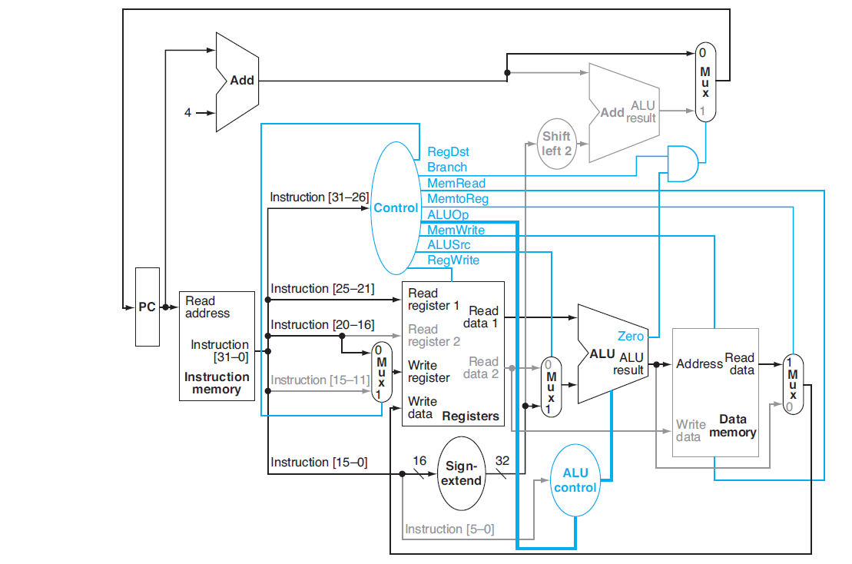
Data Path for lw Instruction-lw $t1,offset($t2)

Slide 5
Data Path for beq Instruction-beq $t1,$t2,offset

Slide 6
Jump Instruction

Slide 7
Why SCI is not Used today?
Performance is Poor
Clock Cycle is too long

